Slide 1

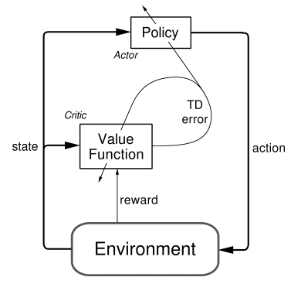




Example
pendulum
Problem
Pendulum Problem(진자운동)
State : {$\sin{θ}$ , $\cos{θ}$, $\dot{θ}$}
* Max_speed = 8
[1 X 3] matrix
Action : {$torque$}
[1 X 1] matrix
${θ}$
Reward : $θ,\dot{ θ}$가 작을 수록 Action이 작을수록 높은 Score
$$\dot{θ}$$
Actor-Critic + DQN → DDPG(Deep Deterministic Policy Gradient)
Actor(Policy_Gradient)
Replay buffer :
샘플간 상관관계를 줄여준다.
Target Q net:
Update시 target을 안정적으로 만든다.
+
Critic(Q - Approximate)

Slide 2
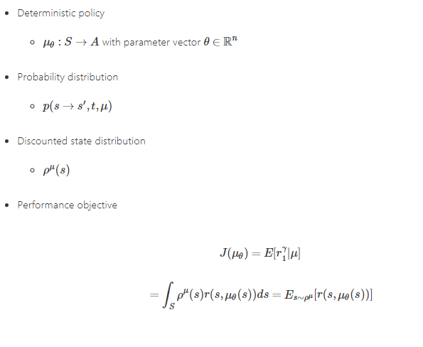
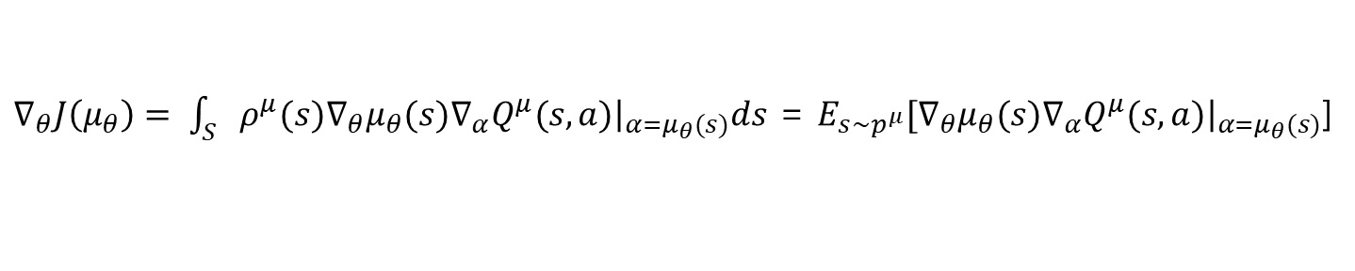
Example
pendulum
Problem
DPG(Deterministic Policy Gradient) Theorem
* DPG Theorem
$∇_{θ}J\left(μ_{θ}\right)= \int_{S}{ρ^{μ}(s)∇_{θ}μ_{θ}(s)∇_{α}{\left.Q^{μ}(s, a)\right|}_{α=μ_{θ}(s)}ds}$ = $E_{s\sim p^{μ}}[∇_{θ}μ_{θ}(s)∇_{α}{\left.Q^{μ}(s, a)\right|}_{α=μ_{θ}(s)}$]

Slide 3
Example
pendulum
Problem
1. Actor Net Class 생성
class ActorNetwork: def __init__(self, session, input_size, output_size, name): self.session = session self.input_size = input_size self.output_size = output_size self.net_name = name self._build_network() def _build_network(self, h_size=128, l_rate=0.0005): with tf.variable_scope(self.net_name): self._state = tf.placeholder(tf.float32, [None, self.input_size], name="input_state") W5 = tf.get_variable("W5", shape=[self.input_size, h_size], initializer=tf.contrib.layers.xavier_initializer()) layer1 = tf.nn.relu(tf.matmul(self._state, W5)) W6 = tf.get_variable("W6", shape=[h_size, self.output_size], initializer=tf.contrib.layers.xavier_initializer()) self.out = tf.nn.tanh(tf.matmul(layer1, W6)) * 2 self._Q1 = tf.placeholder(shape=[self.input_size, h_size], dtype=tf.float32) self._Q2 = tf.placeholder(shape=[self.output_size, h_size], dtype=tf.float32) self._Q3 = tf.placeholder(shape=[h_size * 2, h_size], dtype=tf.float32) self._Q4 = tf.placeholder(shape=[h_size, 1], dtype=tf.float32) layer1 = tf.nn.relu(tf.matmul(self._state, self._Q1)) layer2 = tf.nn.relu(tf.matmul(self.out, self._Q2)) mat = tf.concat([layer1, layer2], 1) layer3 = tf.nn.relu(tf.matmul(mat, self._Q3)) self._Y = tf.matmul(layer3, self._Q4) self._loss = -1 * tf.reduce_mean(self._Y) self._train = tf.train.AdamOptimizer(learning_rate=l_rate).minimize(self._loss) def predict(self, state): x = np.reshape(state, [1, self.input_size]) return self.session.run(self.out, feed_dict={self._state: x}) def update(self, state, Q_1, Q_2, Q_3, Q_4): return self.session.run([self._loss, self._train], feed_dict={self._state: state, self._Q1: Q_1 ,self._Q2: Q_2, self._Q3: Q_3, self._Q4: Q_4})

Slide 4
2. Critic Net Class 생성
Example
pendulum
Problem
class CriticNetwork: def __init__(self, session, input_size, output_size, name): self.session = session self.input_size = input_size self.output_size = output_size self.net_name = name self._build_network() def _build_network(self, h_size=128, l_rate=0.001): with tf.variable_scope(self.net_name): self._state = tf.placeholder(tf.float32, [None, self.input_size], name="input_state") self._action = tf.placeholder(tf.float32, [None, self.output_size], name="output_action") W1 = tf.get_variable("W1", shape=[self.input_size, h_size], initializer=tf.contrib.layers.xavier_initializer()) layer1 = tf.nn.relu(tf.matmul(self._state, W1)) W2 = tf.get_variable("W2", shape=[self.output_size, h_size], initializer=tf.contrib.layers.xavier_initializer()) layer2 = tf.nn.relu(tf.matmul(self._action, W2)) mat = tf.concat([layer1, layer2], axis=1) W3 = tf.get_variable("W3", shape=[h_size * 2, h_size], initializer=tf.contrib.layers.xavier_initializer()) layer3 = tf.nn.relu(tf.matmul(mat, W3)) W4 = tf.get_variable("W4", shape=[h_size, 1], initializer=tf.contrib.layers.xavier_initializer()) self.out = tf.matmul(layer3, W4) self.W1 = W1 self.W2 = W2 self.W3 = W3 self.W4 = W4 self._Y = tf.placeholder(shape=[None, 1], dtype=tf.float32) self._loss = tf.reduce_mean(tf.square(self._Y - self.out)) self._train = tf.train.AdamOptimizer(learning_rate=l_rate).minimize(self._loss) def Q_par_1(self): return self.session.run(self.W1), self.session.run(self.W2), self.session.run(self.W3), self.session.run(self.W4) def predict(self, state, action): x = np.reshape(state, [1, self.input_size]) y = np.reshape(action, [1, self.output_size]) return self.session.run(self.out, feed_dict={self._state: x, self._action: y}) def update(self, state, action, target_Q): return self.session.run([self._loss, self._train], feed_dict={self._state: state, self._action: action, self._Y: target_Q})

Slide 5
Example
pendulum
Problem
3. 학습함수 행성
def Train(Critic_net, target_Critic_net, Actor_net, target_Actor_net, train_batch): x_stack = np.empty(0).reshape(0, input_size) x_1_stack = np.empty(0).reshape(0, output_size) y_stack = np.empty(0).reshape(0, output_size) for state, action, reward, next_state, terminal in train_batch: target = reward + dis * target_Critic_net.predict(next_state, target_Actor_net.predict(next_state)) y_stack = np.vstack([y_stack, target]) x_stack = np.vstack([x_stack, state]) x_1_stack = np.vstack([x_1_stack, action]) Q1, Q2, Q3, Q4 = Critic_net.Q_par_1() Critic_net.update(x_stack, x_1_stack, y_stack) Actor_net.update(x_stack, Q1, Q2, Q3, Q4)

Slide 6
Example
pendulum
Problem
4. 네트워크 분리
def get_copy_var_ops(*, dest_scope_name, src_scope_name): op_holder = [] src_vars = tf.get_collection(tf.GraphKeys.TRAINABLE_VARIABLES, scope=src_scope_name) dest_vars = tf.get_collection(tf.GraphKeys.TRAINABLE_VARIABLES, scope=dest_scope_name) for src_var, dest_var in zip(src_vars, dest_vars): op_holder.append(dest_var.assign(dest_var.value() * (1.0 - TAU) + src_var.value() * TAU)) return op_holder
5. 메인함수
env = gym.make('Pendulum-v0') input_size = env.observation_space.shape[0] # 3 output_size = env.action_space.shape[0] # 1 buffer_limit = 50000 REPLAY_MEMORY = 2000 term = 20 dis = 0.99 TAU = 0.005

Slide 7
Example
pendulum
Problem
5-1. 메인함수
def main(): max_episodes = 1000 replay_buffer = collections.deque(maxlen=buffer_limit) cost = 0 rlist = [] with tf.Session() as sess: Critic_net = CriticNetwork(sess, input_size, output_size, name="Critic") target_Critic_net = CriticNetwork(sess, input_size, output_size, name="target_c") Actor_net = ActorNetwork(sess, input_size, output_size, name="Actor") target_Actor_net = ActorNetwork(sess, input_size, output_size, name="target_a") tf.global_variables_initializer().run() copy_ops_c = get_copy_var_ops(dest_scope_name="target_c", src_scope_name="Critic") copy_ops_a = get_copy_var_ops(dest_scope_name="target_a", src_scope_name="Actor") sess.run(copy_ops_c) sess.run(copy_ops_a) for i in range(max_episodes): state = env.reset() n = 0 for k in range(300): action = Actor_net.predict(state) + ou_noise()[0] if i % 100 == 0: env.render() next_state, reward, terminal, _ = env.step(action[0]) replay_buffer.append((state, action, reward / 100.0, next_state, terminal)) n += reward state = next_state * 1 if terminal: break cost += n if len(replay_buffer) > REPLAY_MEMORY: for _ in range(10): minibatch = rd.sample(replay_buffer, 32) Train(Critic_net, target_Critic_net, Actor_net, target_Actor_net, minibatch) sess.run(copy_ops_c) sess.run(copy_ops_a) if i % term == 0 and i != 0: print("Episode: {} cost: {}".format(i, (cost / term))) rlist.append((cost / term)) cost = 0

Slide 8



Example
pendulum
Problem
Episode : 200
Score: -1500~-1400
Episode : 400
Score: -1000
Episode : 600
Score: -200

Slide 9
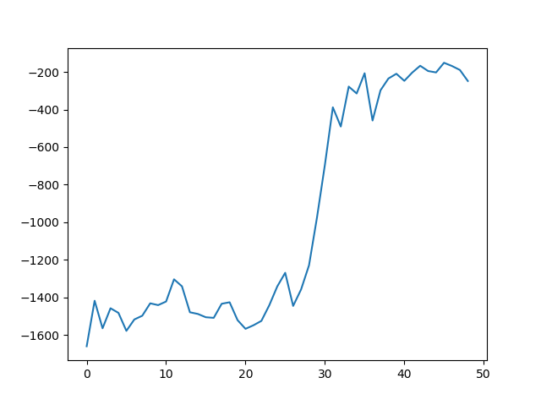
Example
pendulum
Problem
Score
episode

